Slide 1

Onboarding App
Updated: June 9, 2022
Notes:
Note: Grey boxes have been added and some text has been modified for privacy reasons

Slide 2
Summary
This deck includes updated mockups for the UX and Power App team. We are currently working to finalize all mockups included in this deck by early June for Power App implementation.
Link to Figma mockups: https://www.figma.com/file/Xkk9eD21bMWvyWtExih/MCAPS-Academy-Prototype?node-795 (*link broken intentionally for privacy reasons)
Notes:
Note: Grey boxes have been added and some text has been modified for privacy reasons

Slide 3
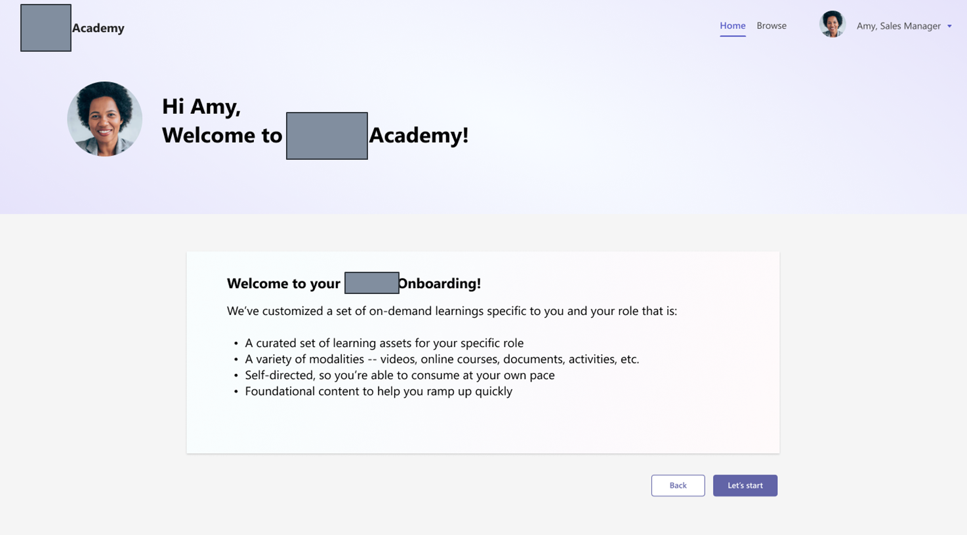
Welcome
Screen
Notes:
Note: Grey boxes have been added and some text has been modified for privacy reasons

Slide 4
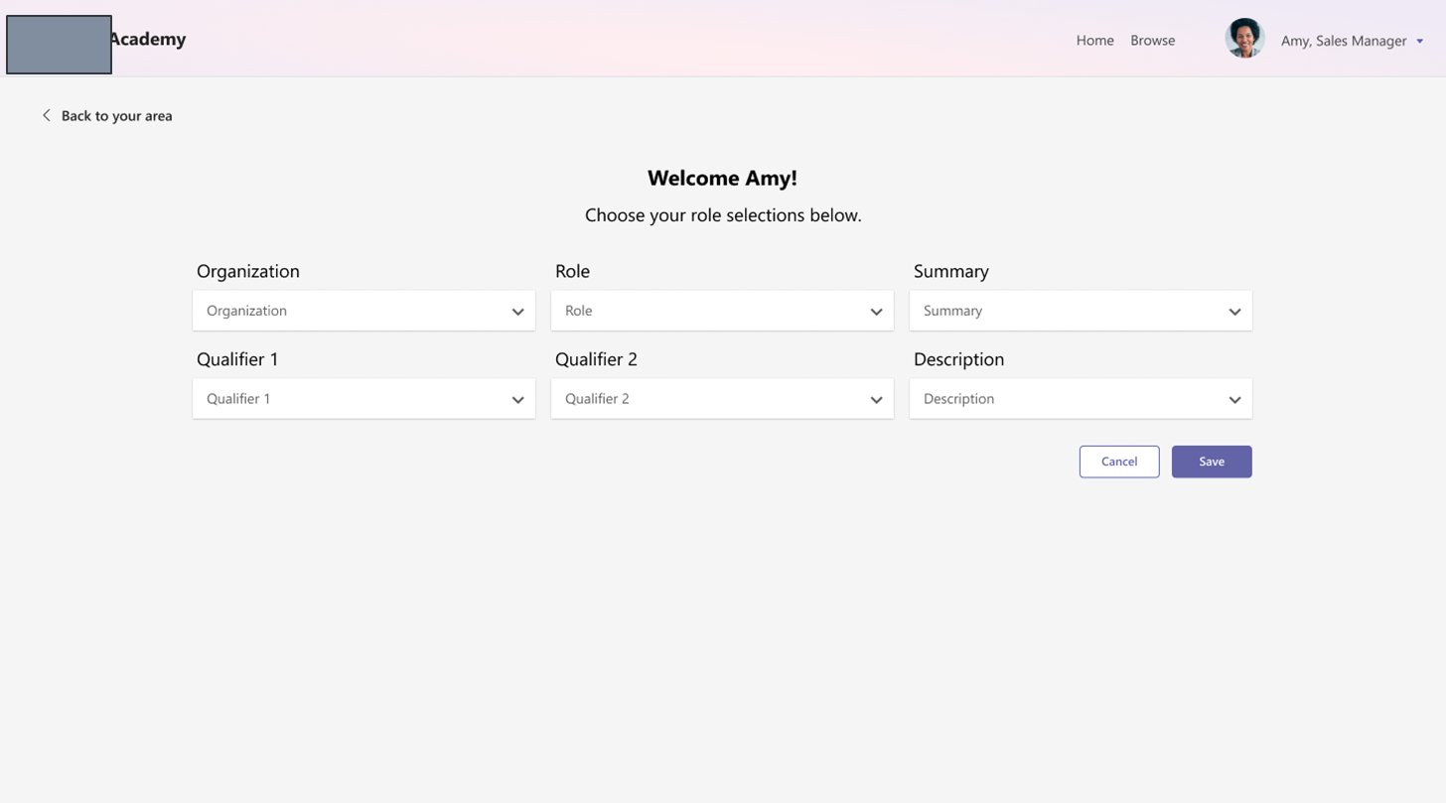
Edit Role
Notes:
Note: Grey boxes have been added and some text has been modified for privacy reasons

Slide 5
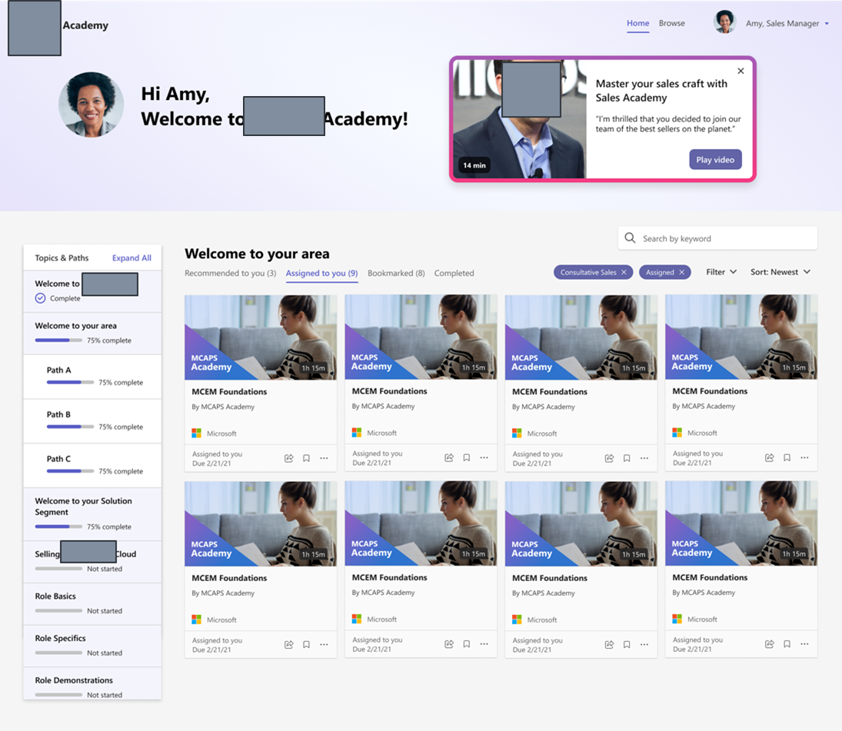
Landing Content
Notes:
Note: Grey boxes have been added and some text has been modified for privacy reasons

Slide 6
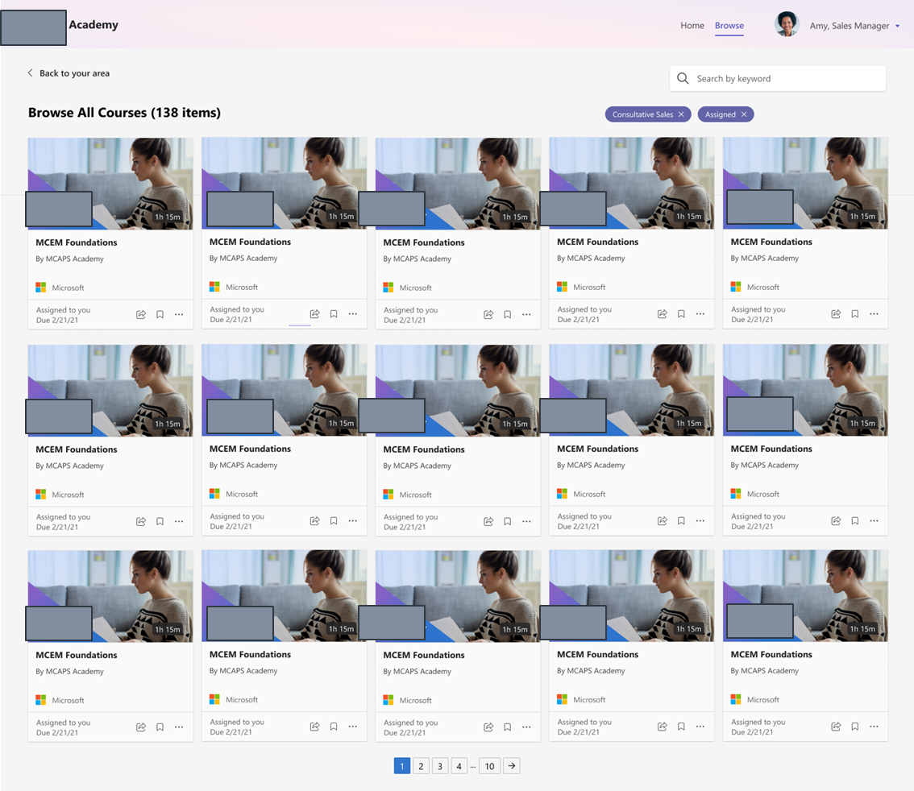
Browse
Notes:
Note: Grey boxes have been added and some text has been modified for privacy reasons

Slide 7
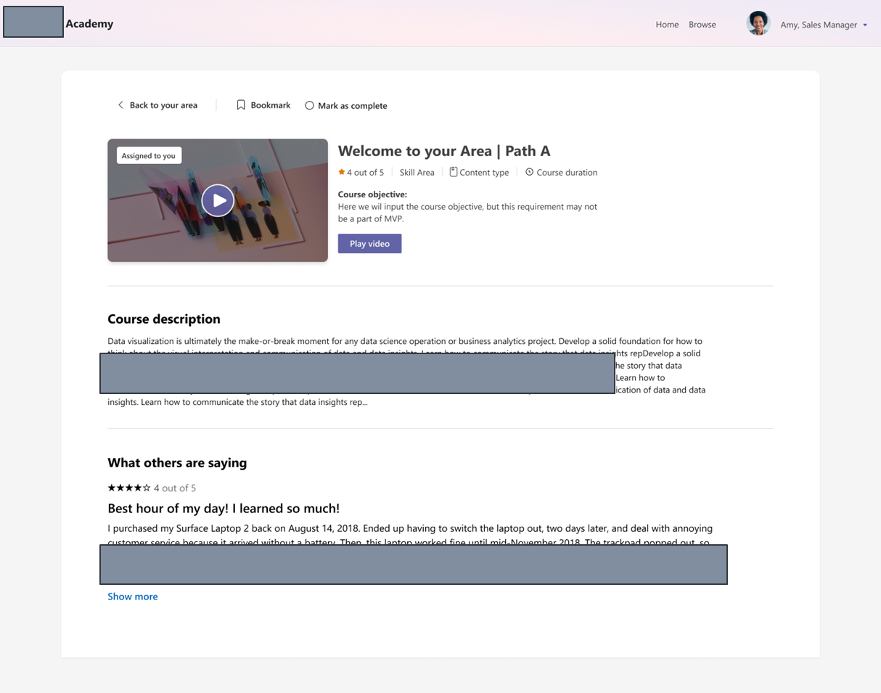
Course Details
Notes:
Note: Grey boxes have been added and some text has been modified for privacy reasons

Slide 8
